Slide 1
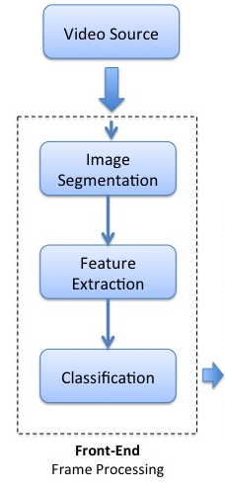
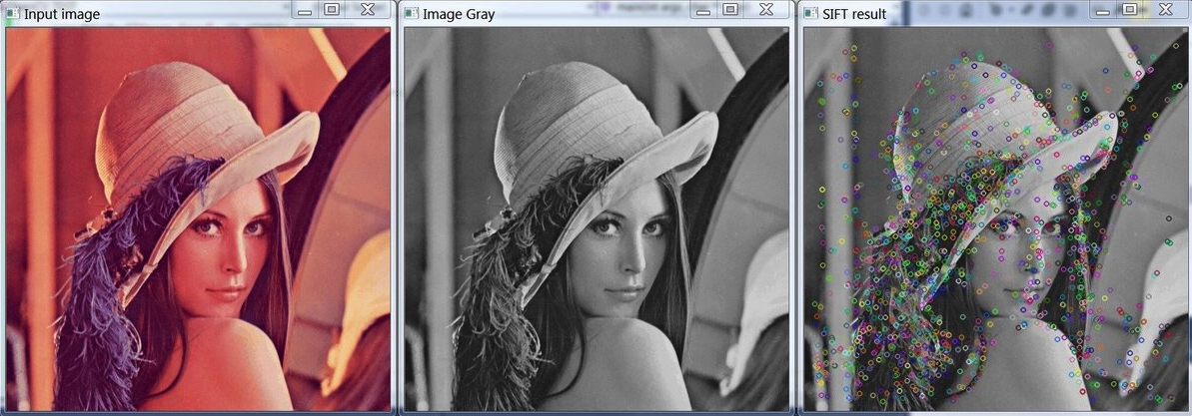

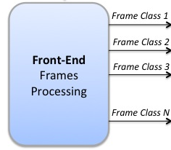
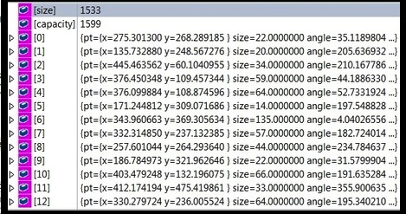
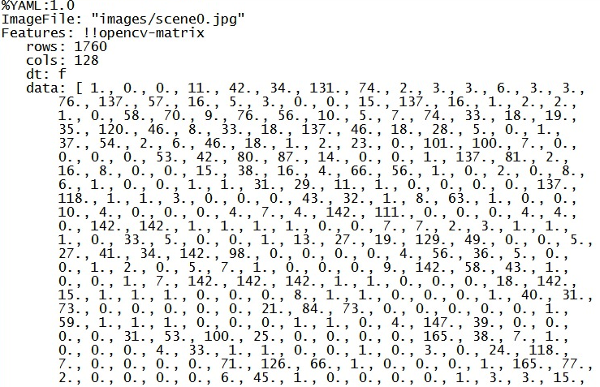
Frame Processing Overview (Layer-B)
Resized
Grayscale
Video
Key Frames
To:
Indexing and Search Unit
Feature
Classification (in progress) ML
Feature Detection
Object Segmentation
(in progress)
IP
Feature Extraction
Feature Properties:
x, y coordinate
Size
Angle
Response
Octave
Very large amount of data!!
Dimension Reduction
Featureset:
128-vector per feature
32-bit floating point
Total memory size:
128 x n x 32/4 = 4096n B
n is # detected features
Data Structures:
XML, YML, custom
Factors considered:
Performance
Memory
Clarity
Library access
Indexing
Notes:
IP: Image Processing
ML: Machine Learning

Slide 2
Layer-B Initial Results
Time & Space Performance
FAST for detection only
SIFT and SURF:
Time and space trade-off depending on application
Use Case (Initial):
Real-time processing: FAST is good
Offline processing: SIFT(faster but more space); SURF(less space but slow)
Less time, more space
Fastest feature detection
More time, less space
*512 x 512 grayscale image
Source image: “lena” 512x512
Best quality, more time
Fair quality, less time
Robustness (1-to-1 Match Perf.)
SURF/SIFT: Very neat matching job; long extraction time
SIFT/SIFT: Fair matching quality; lesser processing time
Algorithm | Description
A | SURF/SIFT
B | SIFT/SURF
C | SIFT/SIFT
D | SURF/SURF
Ranking Table of Matching Quality
5 | Very Good
4 | Good
3 | Fair
2 | Bad
1 | Very Bad
Source images: “dave”, “scene0”

Slide 3
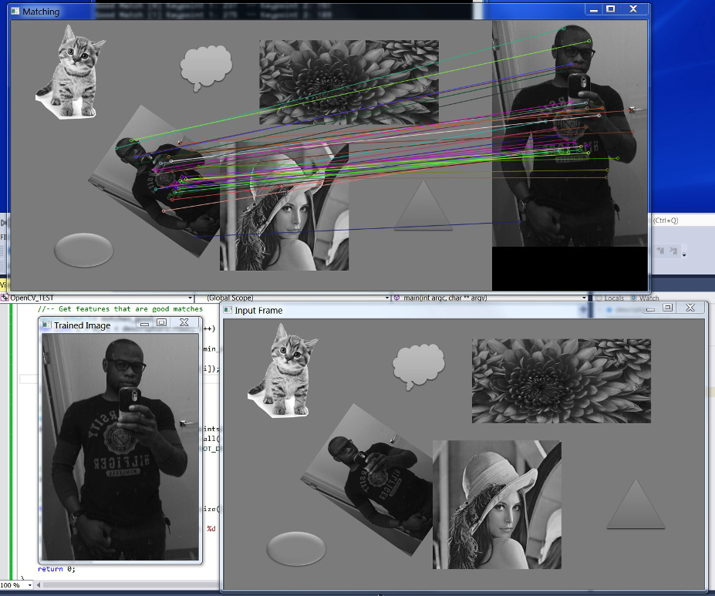
Layer-B Use Case
Input Frame
Reference Frame
Match
(1-to-1)
Online input
Offline-processed data
Okay, Sincre,
find Dave…

